Slide 1
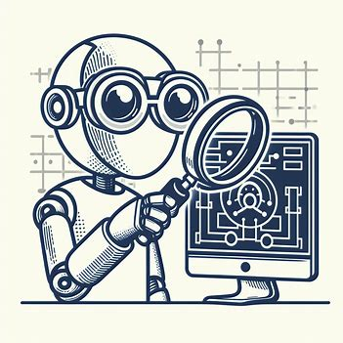
Project Report
01
AI Virtual Proctor
In this project, we develop and implement a virtual proctor using AI/ML that can be used to monitor examination environment to prevent cheating and malpractices.
Computer Vision (IT-420)

Slide 2
Project Report
03
About the Project
Remote proctoring is the act of invigilating an online exam from any location to clamp down on aberrant behavior or cheating instances to ensure a cheat-free assessment environment.
In this project, we present ways to improve reliability of proctoring by generating plots of each parameter measured during the online evaluation.
The project makes use of a webcam and microphone connected to the PC/Laptop. Real-time video processing is enabled and the user is warned if he/she is suspected of cheating.

Slide 3
Project Report
04
Facial Recognition
Real Life
Applications
In virtual proctoring, facial recognition technology can verify the identity of the test-taker and ensure that the person taking the exam is indeed the registered student.
Activity Monitoring
OpenCV can analyze video feeds to detect suspicious behaviors such as talking to someone off-screen, using mobile devices, or attempting to cover the webcam. These behaviors can trigger alerts to proctors or automated systems for intervention.
Authentication and Access Control
OpenCV can be integrated with authentication systems to ensure that only registered students with valid credentials can access the exam. It can also monitor for unauthorized access attempts or multiple users attempting to access the exam simultaneously.
Head Pose Estimation
OpenCV can estimate the orientation of the test-taker's head relative to the screen. This helps detect behaviors such as looking away from the screen or tilting the head, which may indicate cheating or attempting to view unauthorized materials.

Slide 4
Project Report
05
Face Detection
Video Processing
We used MediaPipe (open source cross-platform, customizable ML solutions for live and streaming media) for detecting faces in real-time and drawing bboxes around the detected areas in the image. We make use of Mediapipe's "facemesh" for tracking eyes, mouth opening detection, and head pose estimation.
Face Orientation
The orientation that the face makes with the assumed axis is noted and orientations are classified into straight, right, left, up or down.
Face Recognition
The face detected from the face detector is compared with the registered faces and if an unknown face is detected, the user is suspected to be cheating. We use "Facenet" model for this purpose.o straight, right, left, up or down.
Face Spoofing
It is used for finding whether the face is real or a photograph/image from a phone. The anti-spoofing system is implemented by using a pre-trained model with its weights. The models used so far, could be found under models folder.

Slide 5
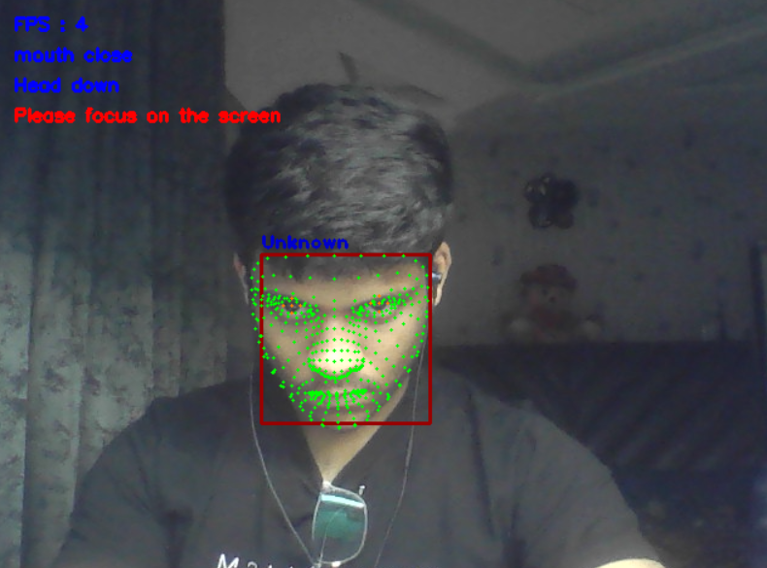
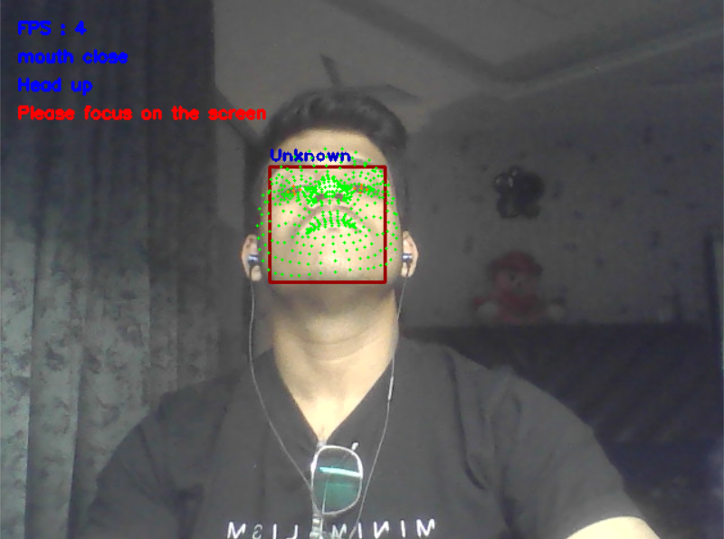
Face Orientation
Face Up
Face Down

Slide 6
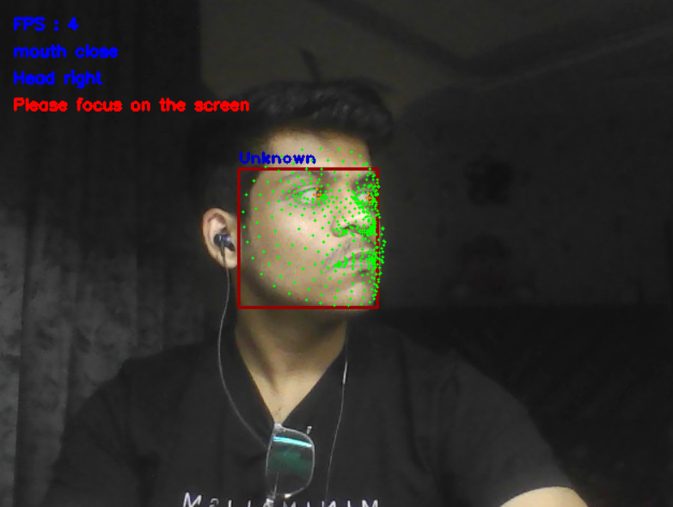
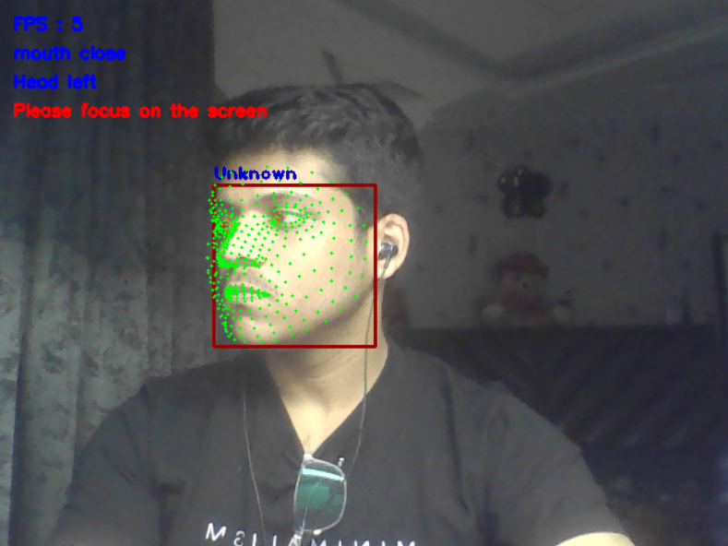
Face Orientation
Face Right
Face Left

Slide 7
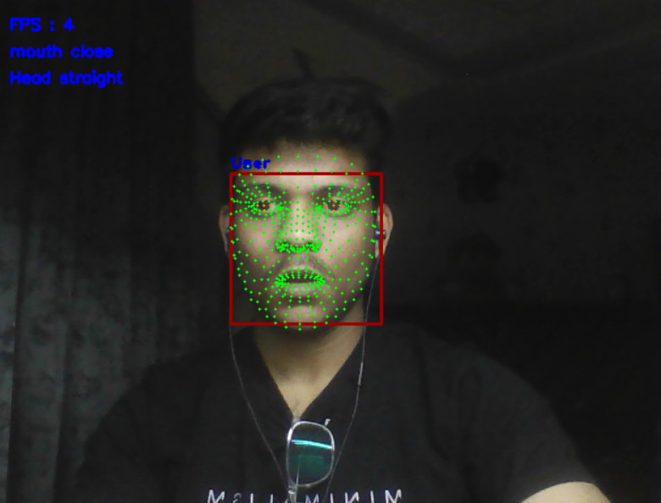
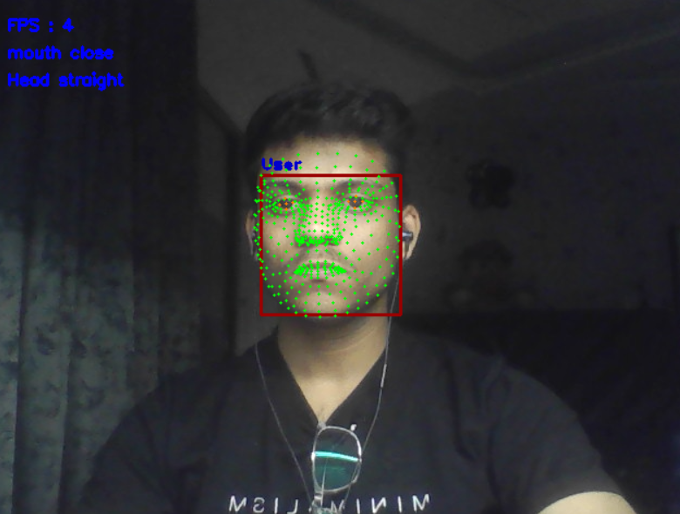
Mouth Orientation
Mouth Open
Mouth Close

Slide 8
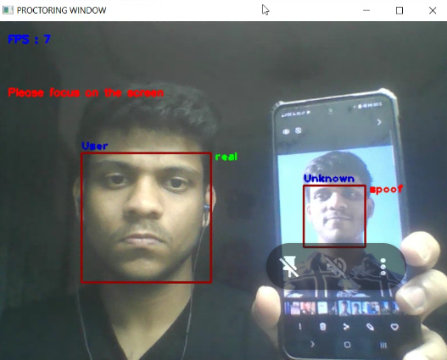
Spoof Detection
Spoofing

Slide 9
Project Report
10
Thank You!

